Slide 1

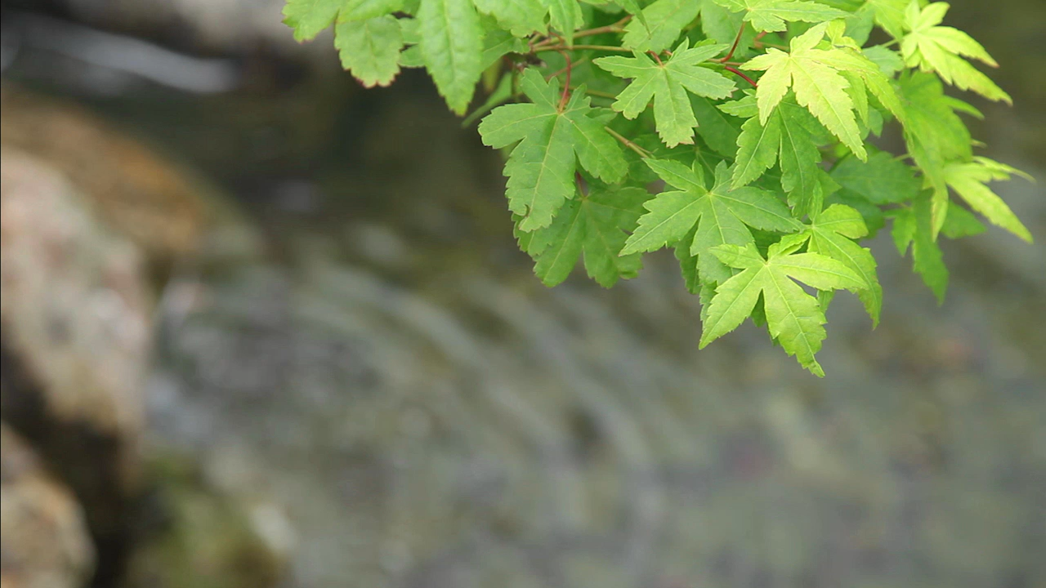

Slide 3
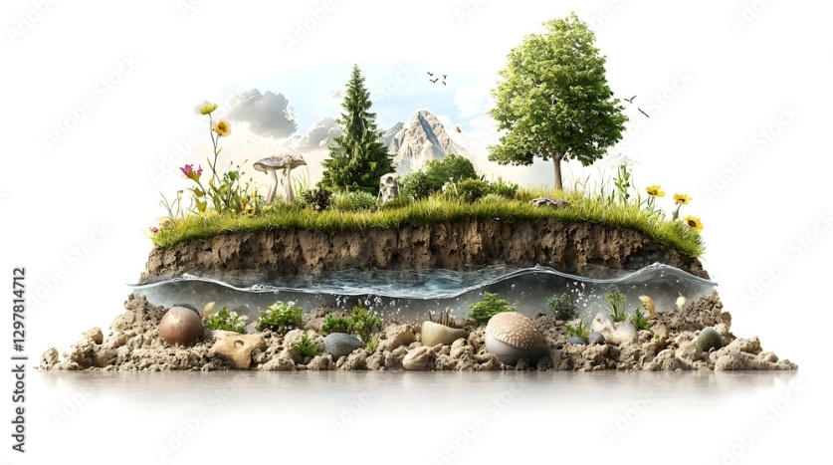
Introduction: Groundwater Depletion
Groundwater is water stored naturally beneath the Earth's surface in underground rock formations called aquifers.
It forms a vital freshwater reserve for billions of people, supporting drinking water, agriculture, and industries.
Over-extraction occurs when groundwater is pumped out faster than it can be naturally refilled by rain and snowmelt.
This leads to groundwater depletion – a persistent decline in water levels that threatens future supply and ecological stability.
The issue is critical as it impacts water security, food production, and environmental health globally.

Slide 4
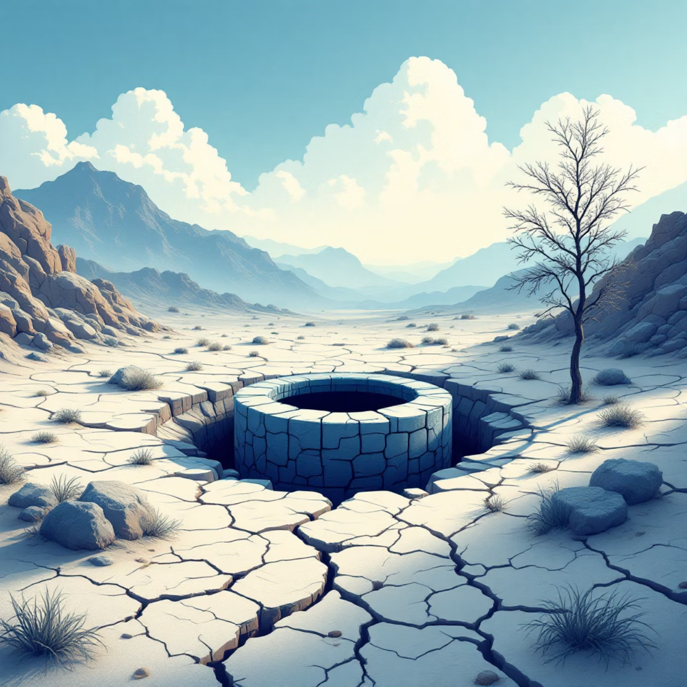
Key Impacts of Groundwater Depletion
Water Scarcity: Diminished access to clean drinking water for communities, affecting over 50% of the world's population who rely on groundwater for daily needs.
Declining Water Table: Leads to increased pumping costs, drying up of shallow wells, and abandonment of water sources in affected regions.
Agriculture & Food Supply: Threatens global food production, particularly in areas where 70% of groundwater is used for irrigation.
Environmental Damage: Causes rivers and wetlands to dry up, land to subside (sink), damaging infrastructure and altering ecosystems.
Future Water Availability: Poses a significant risk to the long-term supply of water necessary for human consumption and ecological balance.

Slide 5

Literature Survey
Groundwater is a critical resource with diverse uses, vital for sustaining populations and economies globally.
10
Food and Agriculture Organization.·70%
20
·
Domestic Use·20%
Industrial Use·10%
70
Source : Central Ground Water Board (CGWB)

Slide 6
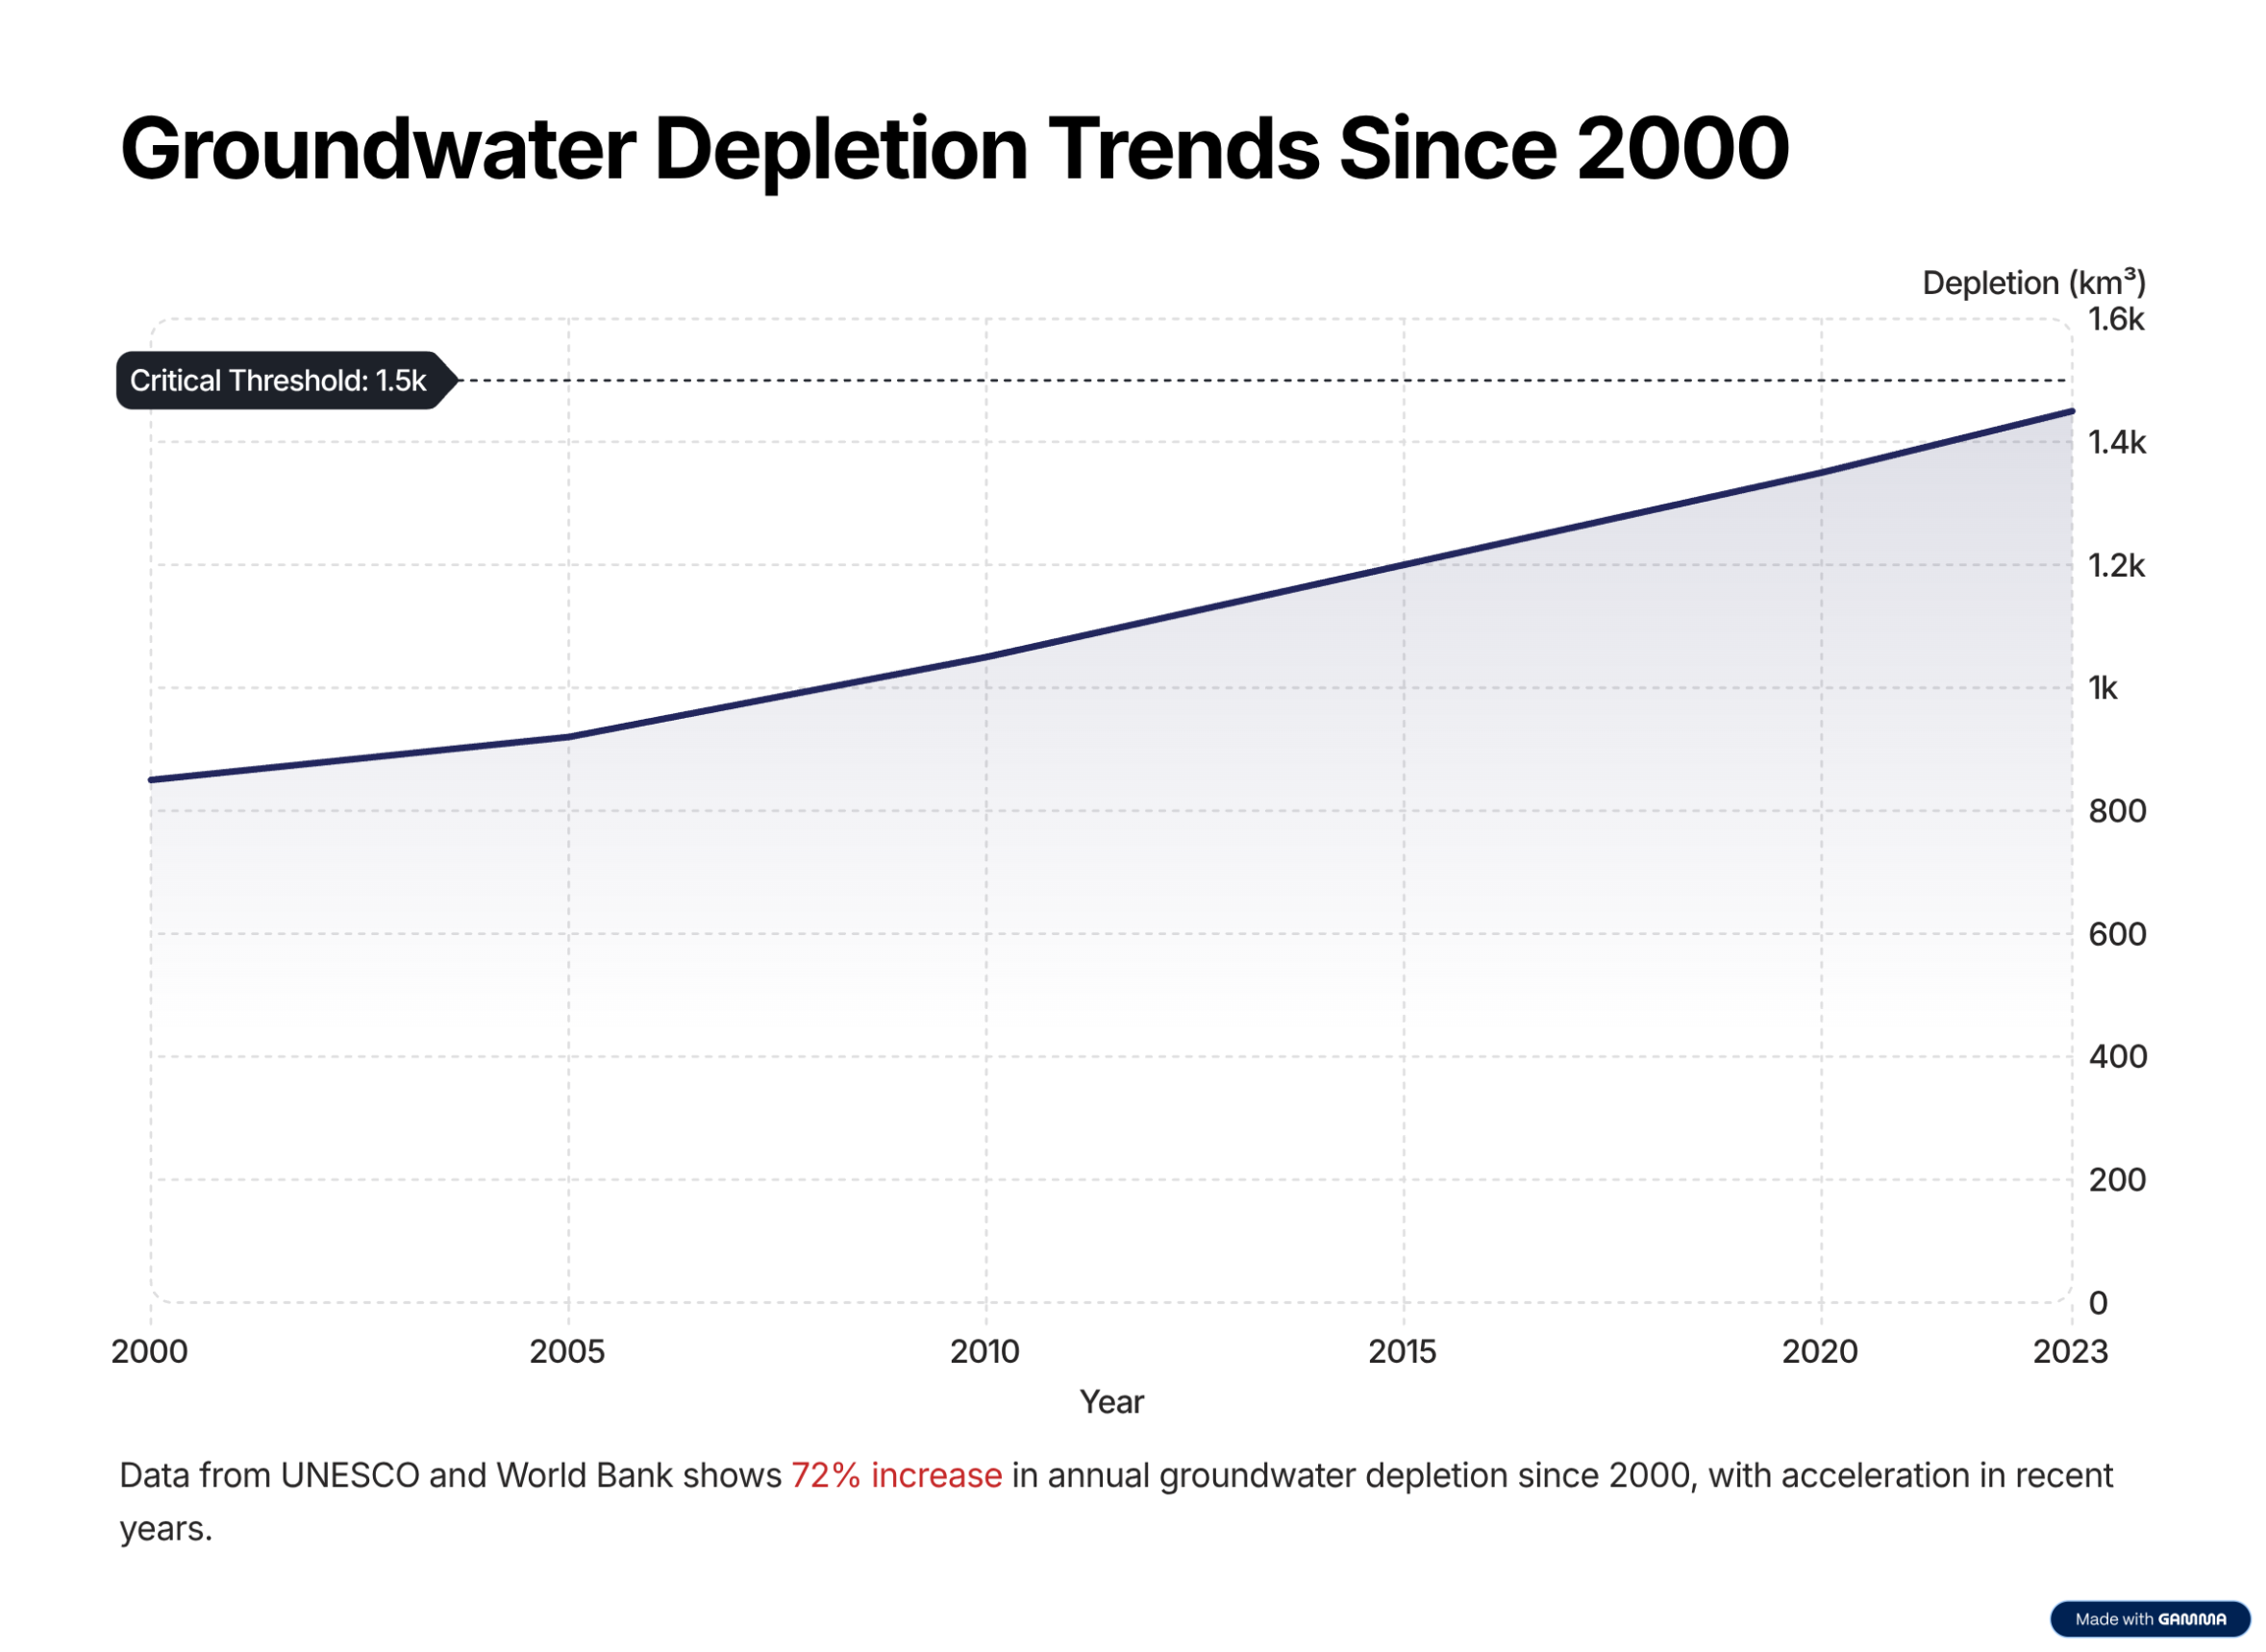

Slide 7
SOLUTIONS
01 Rainwater harvesting: Store rainwater to recharge groundwater.
02 Drip irrigation: Use water-saving methods in farming.
03 Limit over-pumping: Control excessive groundwater extraction.
04 Reuse water: Use treated wastewater for irrigation and other uses.
05 Plant more trees: Helps increase water absorption into soil.
06 Smart groundwater monitoring (IoT): Use sensors and real-time data systems to track groundwater levels and control extraction.

Slide 8
SOLUTIONS
01 Rainwater harvesting: Store rainwater to recharge groundwater.
02 Drip irrigation: Use water-saving methods in farming.
03 Limit over-pumping: Control excessive groundwater extraction.
04 Reuse water: Use treated wastewater for irrigation and other uses.
05 Plant more trees: Helps increase water absorption into soil.
06 Smart groundwater monitoring (IoT): Use sensors and real-time data systems to track groundwater levels and control extraction.

Slide 9
SOLUTION
01 Rainwater harvesting: Store rainwater to recharge groundwater.
02 Drip irrigation: Use water-saving methods in farming.
03 Limit over-pumping: Control excessive groundwater extraction.
04 Reuse water: Use treated wastewater for irrigation and other uses.
05 Plant more trees: Helps increase water absorption into soil.
06 Smart groundwater monitoring (IoT): Use sensors and real-time data systems to track groundwater levels and control extraction.

Slide 10
SOLUTION
01 Rainwater harvesting: Store rainwater to recharge groundwater.
02 Drip irrigation: Use water-saving methods in farming.
03 Limit over-pumping: Control excessive groundwater extraction.
04 Reuse water: Use treated wastewater for irrigation and other uses.
05 Plant more trees: Helps increase water absorption into soil.
06 Smart groundwater monitoring (IoT): Use sensors and real-time data systems to track groundwater levels and control extraction.

Slide 11
SOLUTION
01 Rainwater harvesting: Store rainwater to recharge groundwater.
02 Drip irrigation: Use water-saving methods in farming.
03 Limit over-pumping: Control excessive groundwater extraction.
04 Reuse water: Use treated wastewater for irrigation and other uses.
05 Plant more trees: Helps increase water absorption into soil.
06 Smart groundwater monitoring (IoT): Use sensors and real-time data systems to track groundwater levels and control extraction.

Slide 12
SOLUTION
01 Rainwater harvesting: Store rainwater to recharge groundwater.
02 Drip irrigation: Use water-saving methods in farming.
03 Limit over-pumping: Control excessive groundwater extraction.
04 Reuse water: Use treated wastewater for irrigation and other uses.
05 Plant more trees: Helps increase water absorption into soil.
06 Smart groundwater monitoring (IoT): Use sensors and real-time data systems to track groundwater levels and control extraction.

Slide 13
SOLUTION
01 Rainwater harvesting: Store rainwater to recharge groundwater.
02 Drip irrigation: Use water-saving methods in farming.
03 Limit over-pumping: Control excessive groundwater extraction.
04 Reuse water: Use treated wastewater for irrigation and other uses.
05 Plant more trees: Helps increase water absorption into soil.
06 Smart groundwater monitoring (IoT): Use sensors and real-time data systems to track groundwater levels and control extraction.

Slide 14
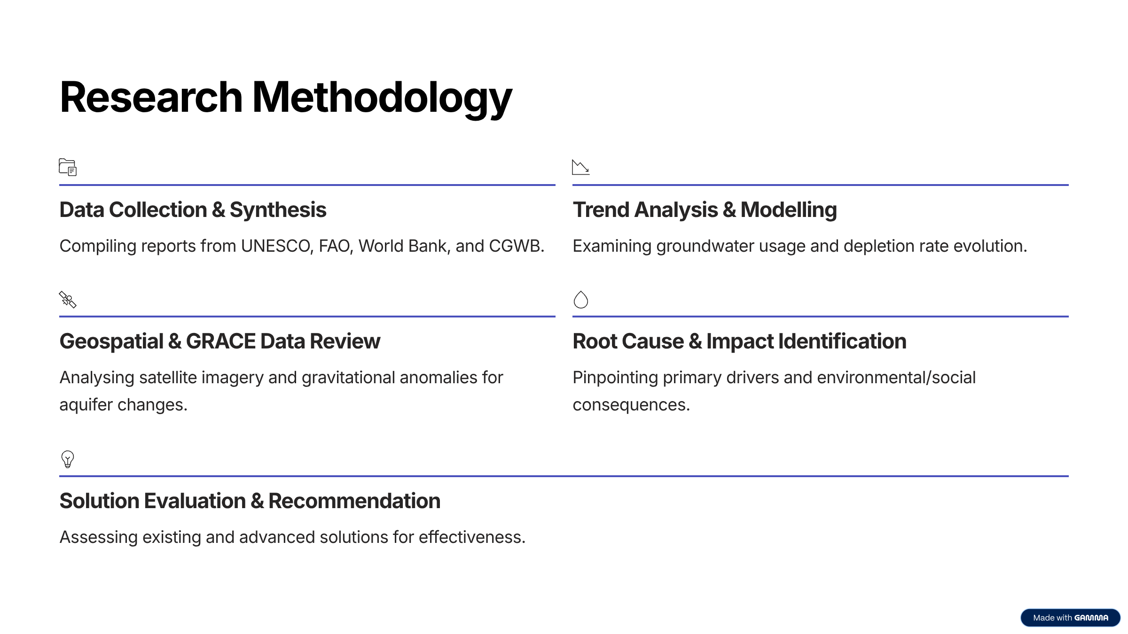
Methodology

Slide 15
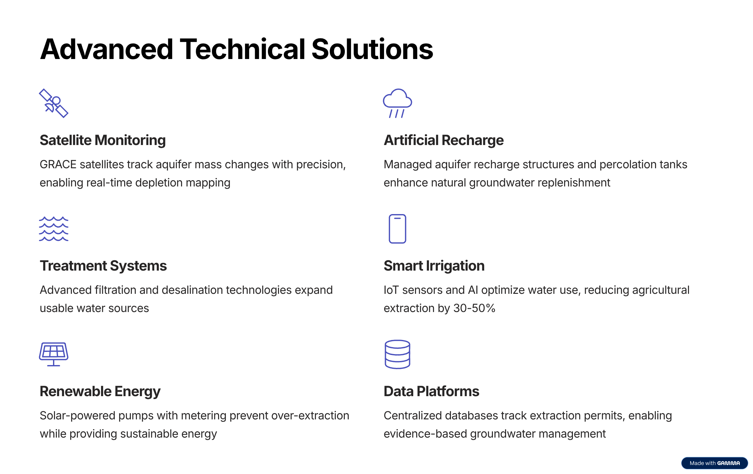

Slide 16
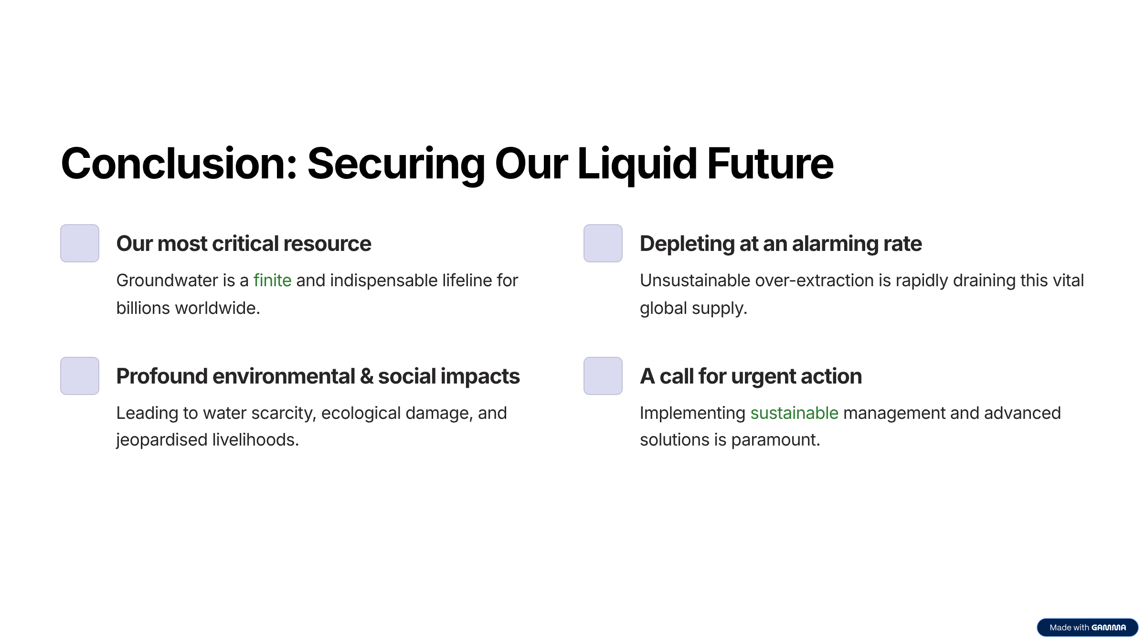

Slide 17


